Slide 1
Cyclistic Casual Members
vs. Annual Members
Presented by: Mital Doolab
Last Updated: August 26, 2022

Slide 2
What was our objective?

Slide 3
Identify how Annual Members and Casual Members are using Cyclistic bikes differently.

Slide 4
Where did the data come from?

Slide 5
Data made available by Motivate International Inc. under this license
Data used in this presentation for analysis is from January 2021 - December 2021 (12 months)

Slide 6
Member Type

Slide 7
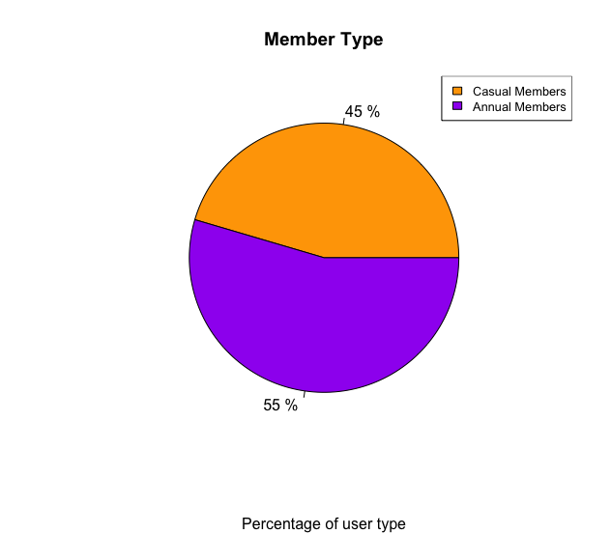
In the year 2021, the percentage of Casual Members and Annual Members was almost equal
How are Casual Members and Annual Members using Cyclistic bikes differently?

Slide 8
What month are Cyclistic bikes used the most?

Slide 9
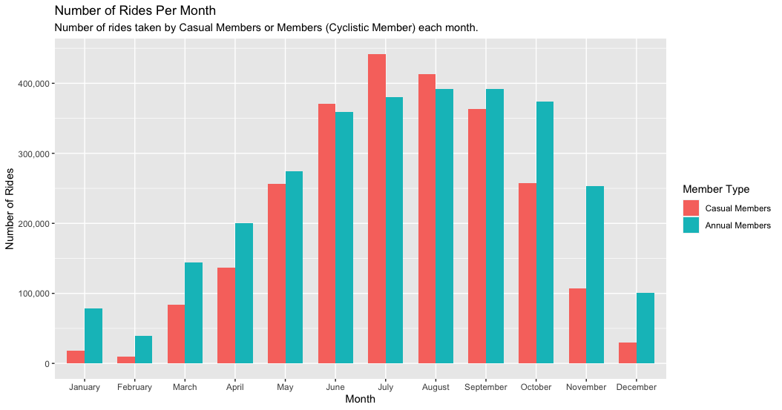
Number of rides for Casual Members and Annual Members is highest from June - August (summer months) and lowest during December - February (winter months)
More rides are taken by Casual members during the summer months (June-August) in comparison to Annual members.

Slide 10
What day of the week are Cyclistic bikes used the most?

Slide 11
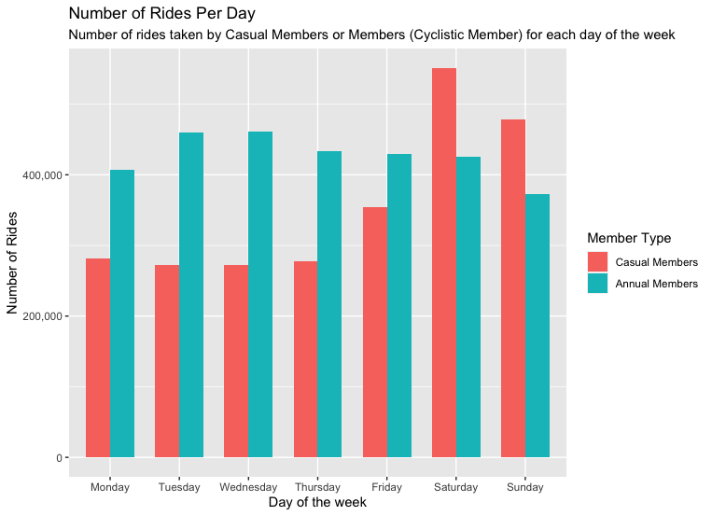
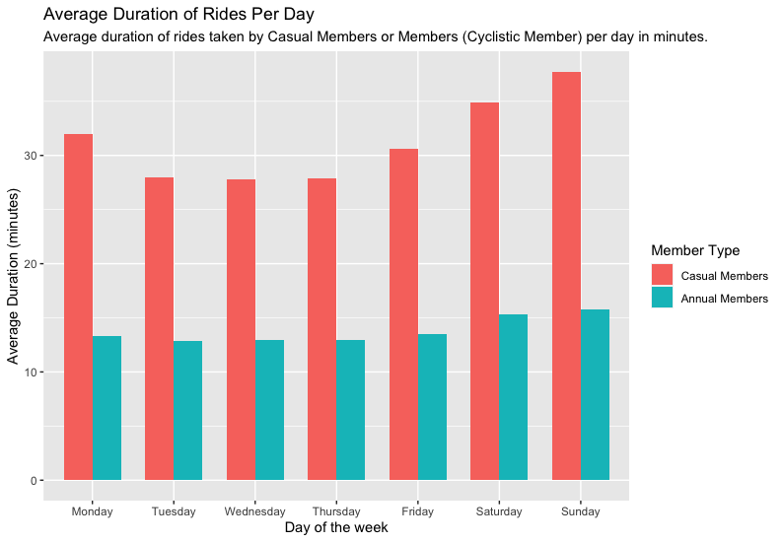
Annual members have a steady number of rides during the weekdays and weekends.
Casual Members take more rides on Saturday and Sunday in comparison to Annual Members.
However, there are longer rides taken by Casual members compared to Annual Members.

Slide 12
What Cyclistic bikes are used the most?

Slide 13
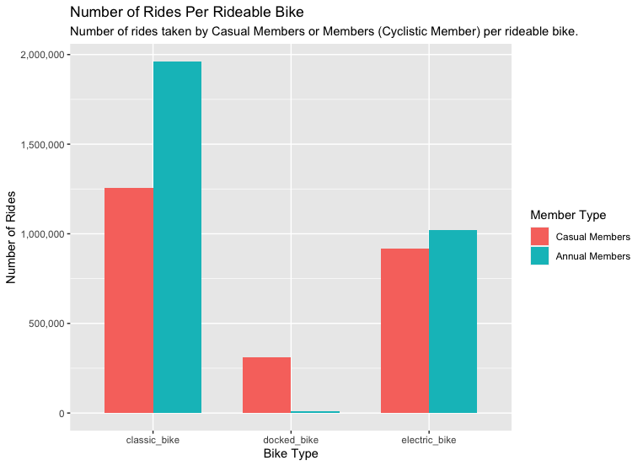
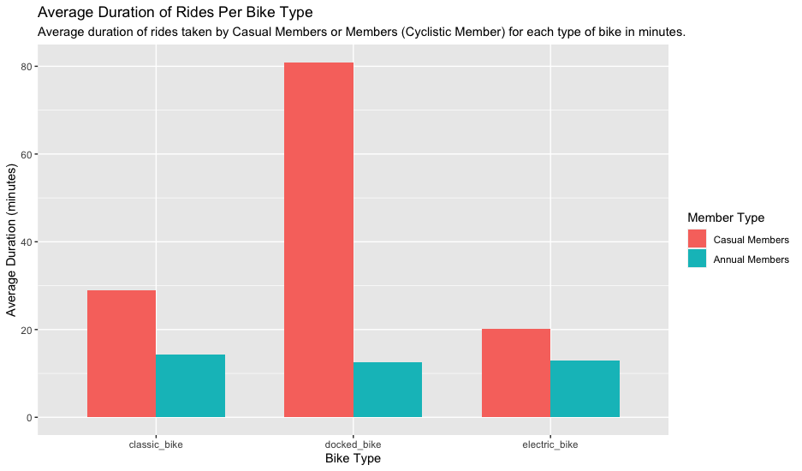
Classic bikes and electric bikes are more popular among Annual Members.
Classic bikes is the most popular among Casual Members followed by electric bikes and then docked bikes.
Casual Members spend the longest duration of time riding all three bikes compared to Annual Members.

Slide 14
Conclusion — Key Findings

Slide 15
1
2
3
Both Casual Members and Annual Members used Cyclistic bikes the more during summer months (June-August) with more usage by Casual Members
Casual Members use Cyclistic bikes more on Saturday and Sunday in comparison to Annual Members.
However, throughout the week including the weekend, Casual Members take longer rides in comparison to Annual members.
Most popular bikes are classic and electric among Casual Members and Annual Members.
However, Casual Members spend a longest duration riding all three bikes compared to Annual members.

Slide 16
Recommendations

Slide 17
Focus marketing strategies to target and convert Casual Members who use Cyclistic bikes during the week to become Annual Members.
Run various promotions and create a Seasonal Annual Membership during summer months when bikes are used the most often to attract Casual Members to sign up as well as attract more subscribers who may have not used Cyclistic bikes or tourists. (Attracting tourists will bring more publicity to our bikes through social media and attract more tourists and more locals to use our bikes.)

Slide 18
Further Analysis is Needed For:

Slide 19
Further analysis is needed before focusing marketing strategy on types of bikes being used → Increase cost to use our most popular bikes “Classic Bikes” and discounted cost to use our least popular bikes “Docked Bikes”
Additional data is required on Start Station name and End Station name to learn which stations are most popular (this data was missing in current datasets).
Which types of bikes are most popular at each station, which can help create marking promotions/strategies and ensure each station is well stocked with those types of bikes.

Slide 20

Q & A
THANK YOU

Slide 21
Appendix

Slide 22
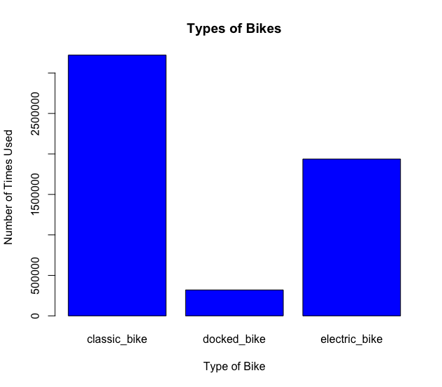

Slide 23
